Slide 1

New Intake Meeting
Caistor C of E and Methodist Primary School
Information for parents/carers of children starting Reception.

Slide 2


Slide 3
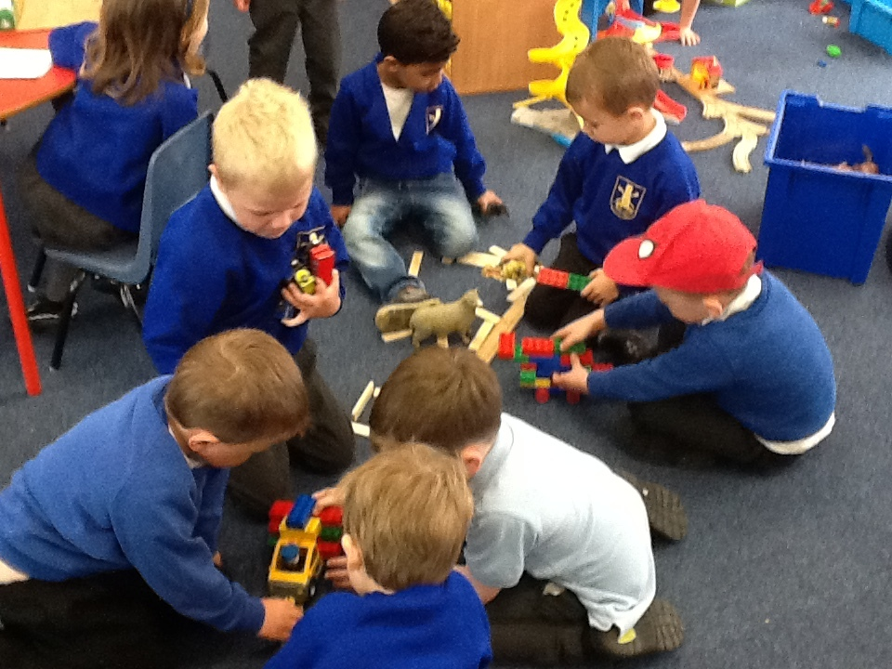
Reception
Children starting Reception will be based in Willow class and are known as ‘Red Group’.
All Reception children will have access to continuous provision and the outdoor area in Willow classroom.
Reception children will be taught phonics, maths and literacy through adult led teaching activities across two classrooms and will then learn alongside preschool children (known as ‘Blue Group’) during child initiated learning time/continuous provision.
As the children move through the year and begin to prepare for their time in year 1, they will spend more time working with teaching staff for focussed learning activities.

Slide 4
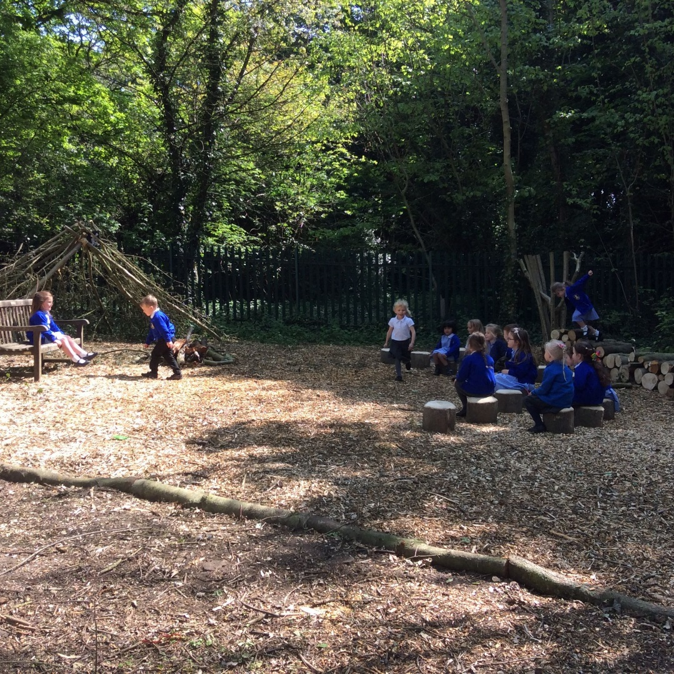
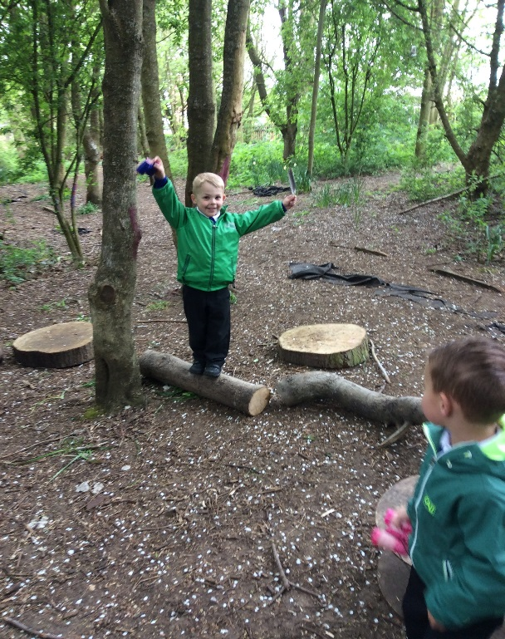
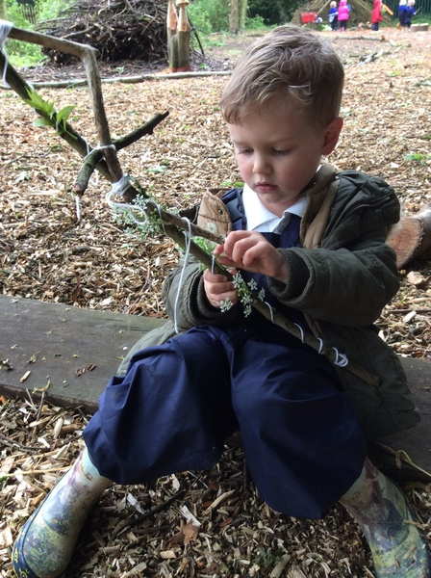
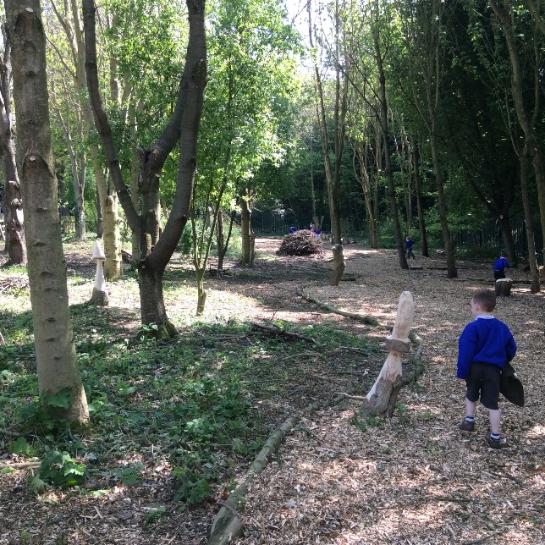
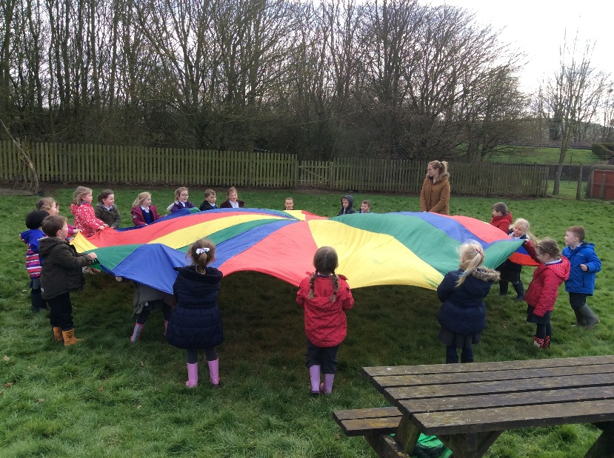
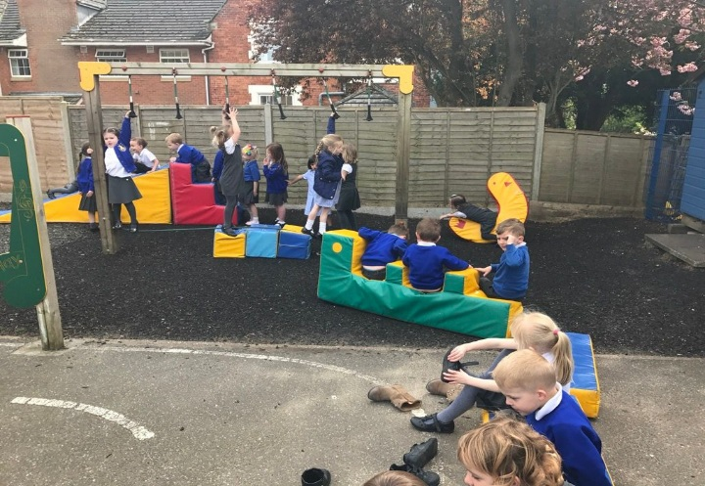
Our environment
As well as large multipurpose classrooms, a secure outdoor area and large playgrounds, we also have our own woodland area.
We use this area every week, on Wednesdays and are lucky enough to have our own fully qualified Forest Schools practitioner in school.

Slide 5
Starting School
Doors Open – 9:00am
Your child will need – School uniform, PE kit, packed lunch (if not having a hot lunch), coat, wellies, a water bottle and a book bag. Children can store their wellies at school for the duration of each half term.
Where to go – Children will line up on the playground, with separate lines for Preschool and Reception, where they will be greeted by their teachers.
What to do – Parents/carers are encouraged say goodbye to their child and leave as soon as their child is settled.
If your child is unsettled – A member of staff will support your child as soon as possible.
Home time – Children will be lined up at classroom doors, with parents waiting on the playground. Staff will match children to their parent/carer one at a time – please be very patient as this can take quite some time in the first weeks, as we learn new faces. We will begin to send the children out from 3:25. Gates will be opened for parents to enter the playground from 3:20.

Slide 6
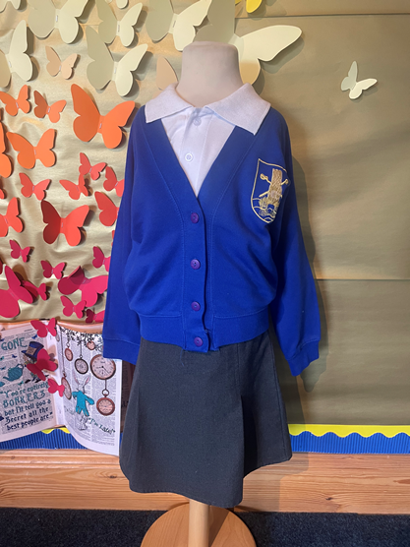
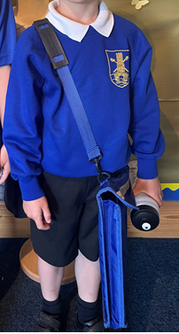
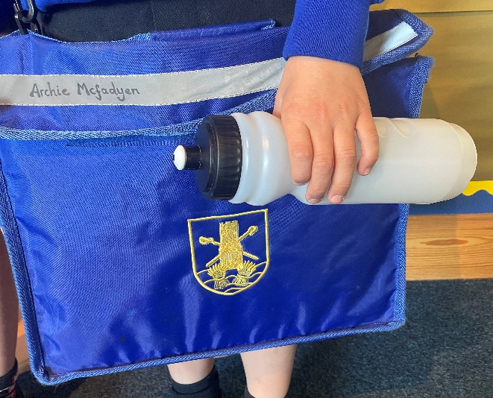
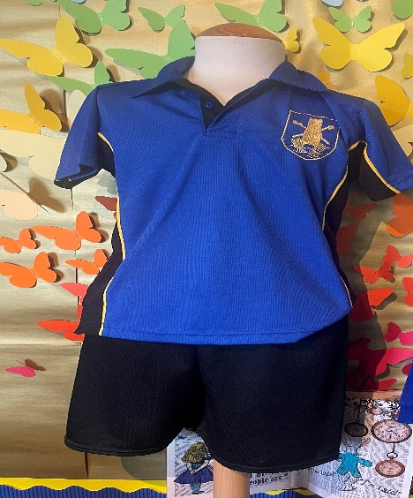
School uniforms and PE kits can be purchased from Uniform Direct or ordered via
https://www.uniform-direct.com/acatalog/Caistor-C-of-E-Methodist-Primary-School.html
Children can wear either trousers, shorts, summer dress, skirt or a pinafore. Please see the school uniform policy on the school website for more information.
Children will also need a book bag/rucksack and a water bottle.
Please ensure that all belongings are clearly named.
Children will need a pair of plimsolls or trainers for PE lessons.

Slide 7
Lunchtime and playtime
We encourage all children to take up the Universal Free School Meal option, which is prepared on site each day. Alternatively, they may bring a healthy packed lunch
Please speak to a member of the admin team to arrange order forms or visit the school website if you would like your child to have a free hot school meal
All children will be taken to the dining room at 11.50am and teaching staff will stay with them until they are all settled
Once all children have finished eating, they will be taken as a group, to play on the key stage 1 playground/field to play
Children have access to the outdoor area in all weathers. Playtimes vary depending on the day’s activities. Children remain with Reception staff on the key stage 1 playground/field for all playtimes
Please provide appropriate clothing according to the weather.
Wellies to be kept in school all year, if possible, to allow children opportunities to join in with regular woodland activities.

Slide 8
Daily routines and timetables
Relaxed timetable to allow for settling in time during the first weeks
Children will work throughout the day in small groups with practitioners to develop basic skills such as communication skills, social skills and physical development skills
Forest Schools – once per week on a Wednesday. Children to come to school in play clothes
PE - once per week on a Friday morning. Children to come to school in PE Kit
Typical daily routine
9:00-9:15 | 9:15-9:50 | 9:50-11:50 | 12:00-1:00
Welcome and register | Phonics | Literacy groups and child initiated time | Lunchtime
1.00-1.20 | 1.20-2.35 | 2.35-3.00 | 3.00-3.20 | 3.20-3.25
Register and maths input | Maths groups and child initiated learning time | Whole group playtime | Milk time and story time | Getting ready for home time

Slide 9
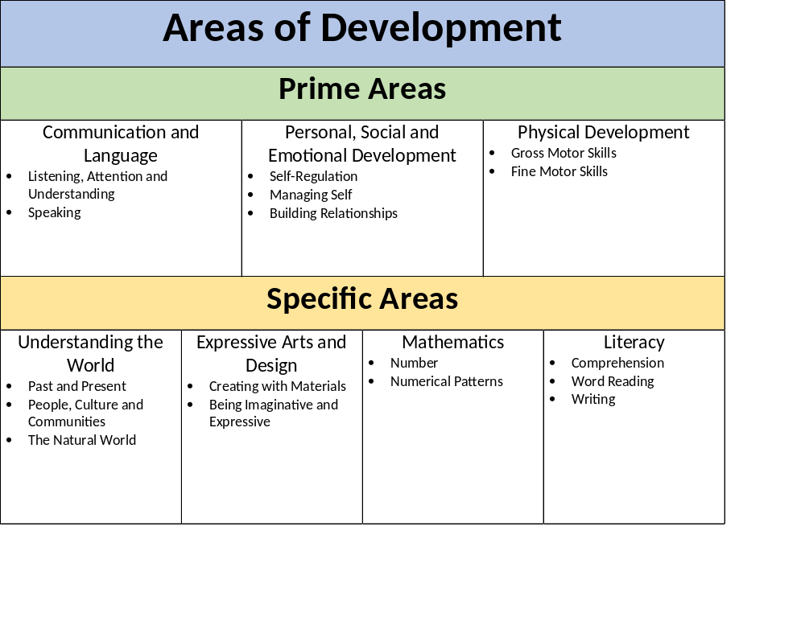
School readiness and the curriculum
There are 17 areas of learning and development outlined in the new 2021 EYFS Framework
Children are all individuals and learn at different rates and make progress more quickly in some areas than others
Children will be encouraged and supported to develop their individual personalities, talents and interests
Children will be supported where there are gaps in their learning or they require more help – this includes toileting, dressing, communication, social development
Suggestions – independent toileting (wiping), putting on own coat and shoes, taking off jumper/cardigan

Slide 10

Learning Journeys, news and photos
Tapestry
Communication
PROGRESS and LEARNING
Secure website for parents/carers to view children's progress, achievements and milestones.
Unique login and password
Parent/carer contributions encouraged
You will be invited to register your account, via email, during the first week in September.
Parent Pay – booking lunches, news letters, information, dates
School website – Curriculum information, photographs, dates, information
Facebook page – information and highlights
If you need to report your child’s absence, please contact the school office
If you wish to contact a member of staff to discuss anything related to your child, please make an appointment by contacting a member of the admin team.

Slide 11

Finally
Name EVERYTHING!!!
Please do not allow your child to bring toys to school
Don’t plan a busy weekend during the first week or two as children will be very tired
Brace yourself for tears in the second week. Sometimes the first week is very exciting and then children become tired and emotional in the second week
Most importantly…..we are here for you and your child. We have an open door policy. Please speak to us if you have any worries or concerns.

